Slide 1
CS 4350: Fundamentals of Software Engineering Lesson 5.3 Testing Systems
Jonathan Bell, Adeel Bhutta, Ferdinand Vesely, Mitch Wand
Khoury College of Computer Sciencesa
© 2022 Released under the CC BY-SA license

Slide 2
Outline of this lesson
How can we test complex systems?
What are some ways to substitute out parts of the system?

Slide 3
Learning Objectives for this Lesson
By the end of this lesson, you should be able to:
Be familiar with test “doubles” such as “stubs, mocks, spies, fakes”
Contrast “mocks” and “spies” in testing;
Describe the limitations of automated testing;
Give some useful examples of nondeterministic testing.
For Further Reading – Check out Martin Fowler’s article, “Mocks Aren’t Stubs” https://martinfowler.com/articles/mocksArentStubs.html

Slide 4
Large Systems are Hard to Test
Database component
Contents may need to reflect/simulate real-world;
Data may be expensive/proprietary/confidential.
Network connections
”Real” connections may be slow/flaky/disrupted;
Resources may have changed since test was written.
Environment
Interactions with OS, locale or other software.
Human actors
Ultimately unpredictable.
4

Slide 5
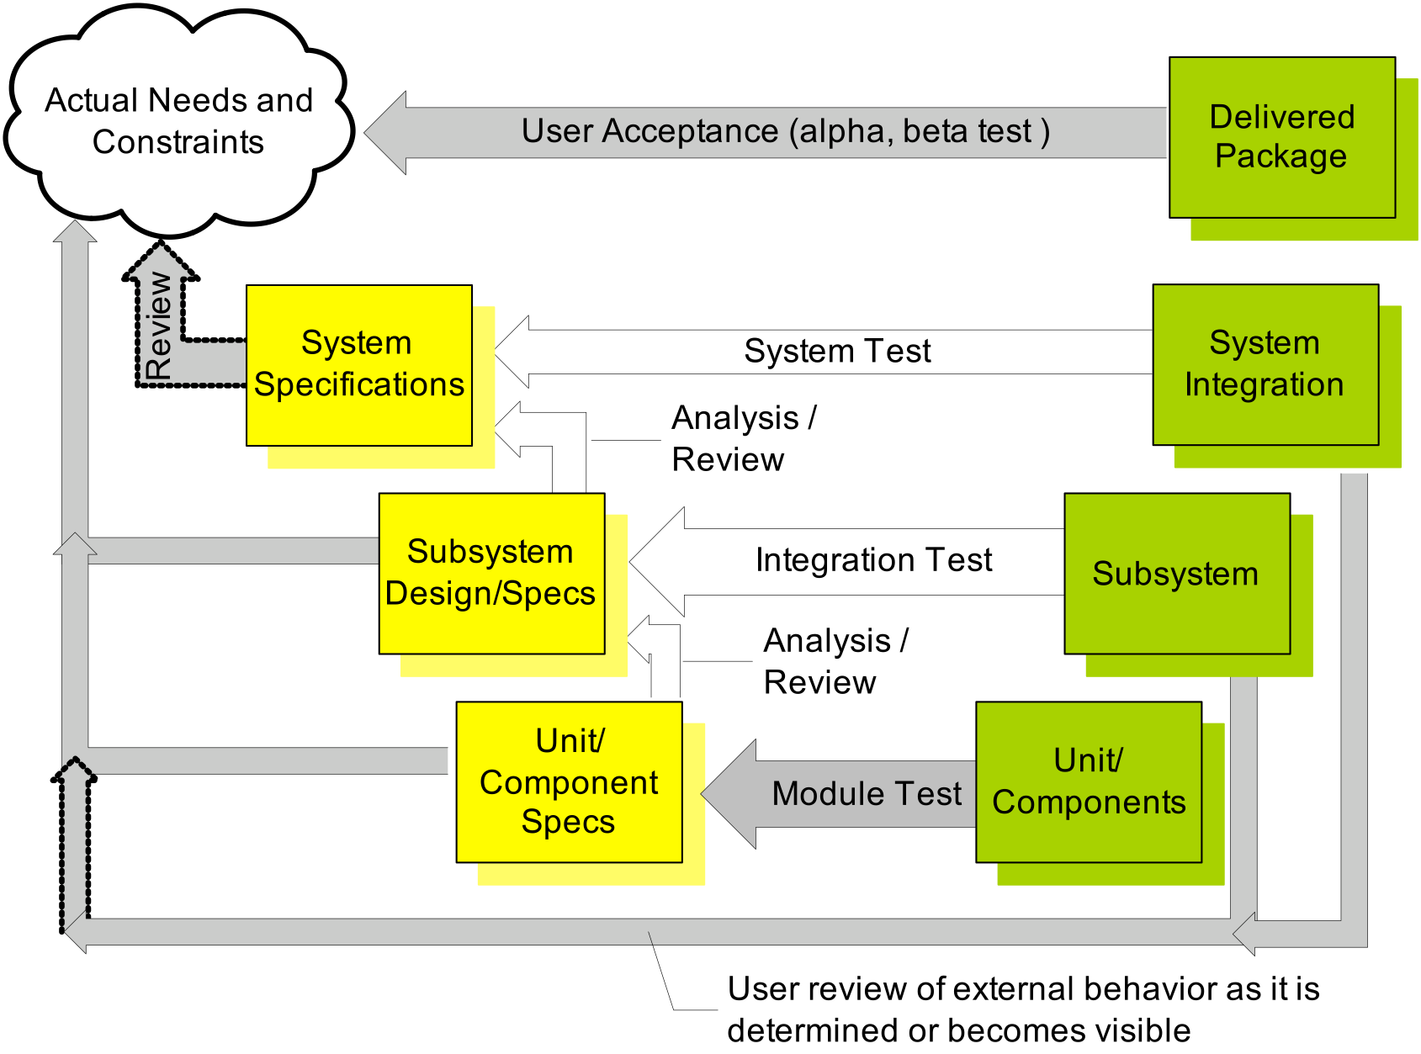
Unit Testing is not sufficient
Typical use Drivers and Stubs
Overall systems are “a little more” complicated
Driver
Stub
Stub
5

Slide 6
Two Ways to Handle Difficulties
Pay the cost, do the test
Automate with tools:
A large test can reveal problems that smaller tests can’t.
Choose particular times (rare!) to do particular large tests.
An “enormous” test at Google simulated an earthquake in Mountain View, CA.
See Chapter 14 of SE@Google
Use “Test Doubles”
Stubs
Mocks / Spies
Fakes
Random testing
“Fuzzing”
Against a reference implementation.
Rest of
Lesson

Slide 7
Test Double Example
Mo
Business Logic
Network
Resources
Random user
Database
Mock network
Fake Database

Slide 8
Test Stub
Supply an object with the same interface:
Same methods;
Default result values.
The stub gets the test to run:
If the client blindly uses the stub, it can proceed;
If the client expects something from the object, the test will likely fail.
Need two more things:
Remember how the stub was used;
Tell the stub what to do when it is called.

Slide 9
Test Spies
A test spy remembers how the object was called
Then the test harness can check what happened;
For example: a particular method should be called
First with parameters “foo” and 42;
Then with parameters “quux” and -88.
A spy can be useful on the “real” object:
What was sent on the network?
How many times a problem was logged?
What was inserted in the database?
But most often used with a “mock.”
Spy “remembers”

Slide 10
Test Mocks
A test mock has scripted results:
If such-and-such a method is called
return some particular value.
A complex mock can have many scripts:
Multiple methods;
Different results for subsequent calls.
Useful mocking assumes we know how mocked object will be used.
If a “mock” has real logic, it becomes a “fake”.
Mock has “scripted answers”

Slide 11
Test Fakes
A fake has an implementation of the object being replaced
A low-fidelity fake implements things partially
Enough to work for the test.
A high-fidelity fake implements most aspects:
Usually all functional aspects;
Usually not as efficiently or as scalable.
The purpose of the fake is to avoid processes/network/cost:
So the test can be cheap and deterministic.
Fake has
“semi-real implementation”

Slide 12
Random Input
To replace a user, we can program a “bot”
Randomly use mouse, press buttons;
Arbitrary text;
Fast or slow.
Smarter (“Fuzzing”)
Capture real actions;
Then make targeted mutations.
(This applies also to programs taking text input.)
Expected result can only be imprecise:
E.g., “not crash” or “not leak secrets”.

Slide 13
Related: Random Testing
SUT
Random
Input
Generator
=?
Errors
Ref.
Impl.

Slide 14
Weaknesses of Test Doubles
The Mock/Fake may not behave correctly
The test harness may assume wrong behavior;
Particularly an issue if original object changes
Mocks have to be maintained as well!
Solution: Test the mock/fake against a higher fidelity fake, or against the real thing.
The SUT may use a different algorithm:
The Spies expect a particular usage of double;
The test is “brittle” because it depends on internal behavior of SUT;

Slide 15
Review: Learning Objectives for this Lesson
You should now be able to:
Be familiar with test “doubles” such as “stubs, mocks, spies, fakes”
Contrast “mocks” and “spies” in testing;
Describe limitations of automated testing;
Give some useful examples of nondeterministic testing.

